Slide 1
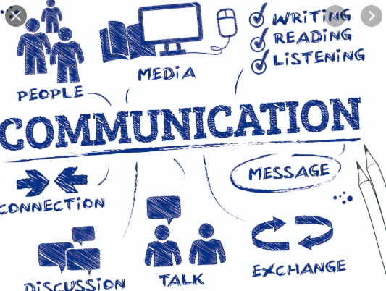
EFFECTIVE COMMUNICATION
Applicable tactics to use over the telephone

Slide 2
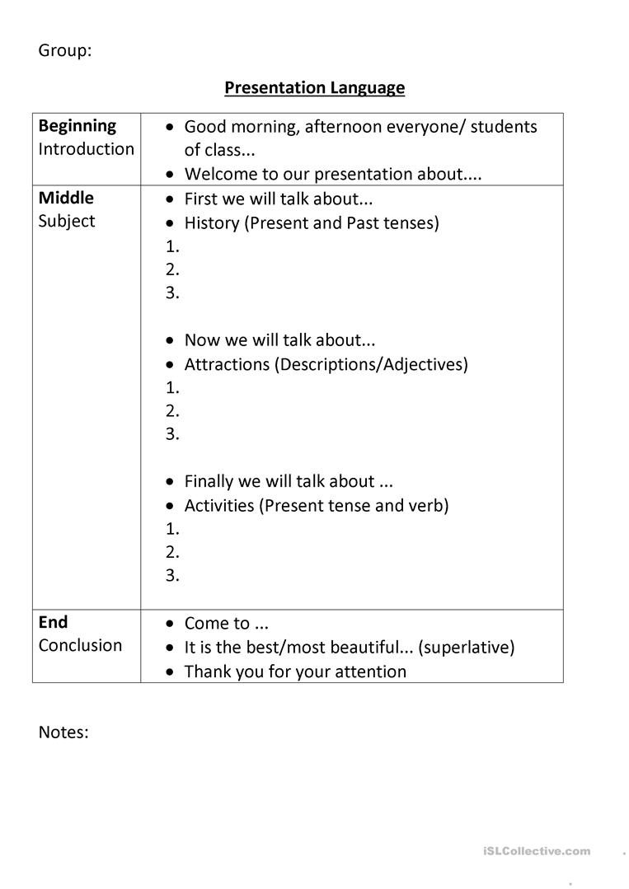
Prepare for the call
Find a quiet spot without distractions prior to making the call.
Do not write a script but note down important points in a prompt sheet and place it in front of you while making the call.
Also consider probable time differences and diction
Notes:
Make sure not to develop a script for the conversation, because it will interrupt the flow and also will not sound natural. It is effective to be fully concentrated on the call for both parties, so consider factors that may limit concentration on both ends

Slide 3
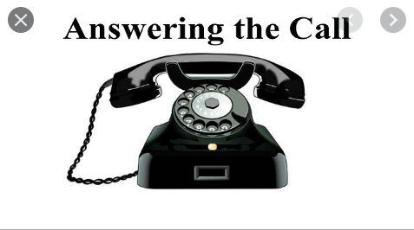
Specify your identity when answering the call
Not knowing whom the other party is makes the conversation dull and disorienting.
Commence the conversation with a bright and lighter tone
Notes:
Addressing either party in the conversation requires identification from both ends, even as a formality. It also presents to the listener how the other party may like to be addressed as.

Slide 4

Speak with clarity
Avoid speaking to hastily, gushing and mumbling, and ensure you pronounce your words well.
You can also speak slowly or a little louder based on the language or other barriers.
Clarity should also reflect on what you both seek to achieve.
Notes:
You can even seek out relevant diction prior to making the call, and ensure to note down proper pronunciation. It is also efficient to be clear about the purpose of the call, which will structure the conversation to a resolution for both

Slide 5

Adjust your speech to be sensible to second party
Take into account the other person and adjust your language to fit the listener.
Take into context their age, cultural background, and other contributing factors that may limit understanding.
Notes:
Communications could be with different age groups, cultural backgrounds, or cultures. Effective communications takes the factors into account by appreciating the differences and respecting what the other holds in high regard. Be sensitive and adjust

Slide 6
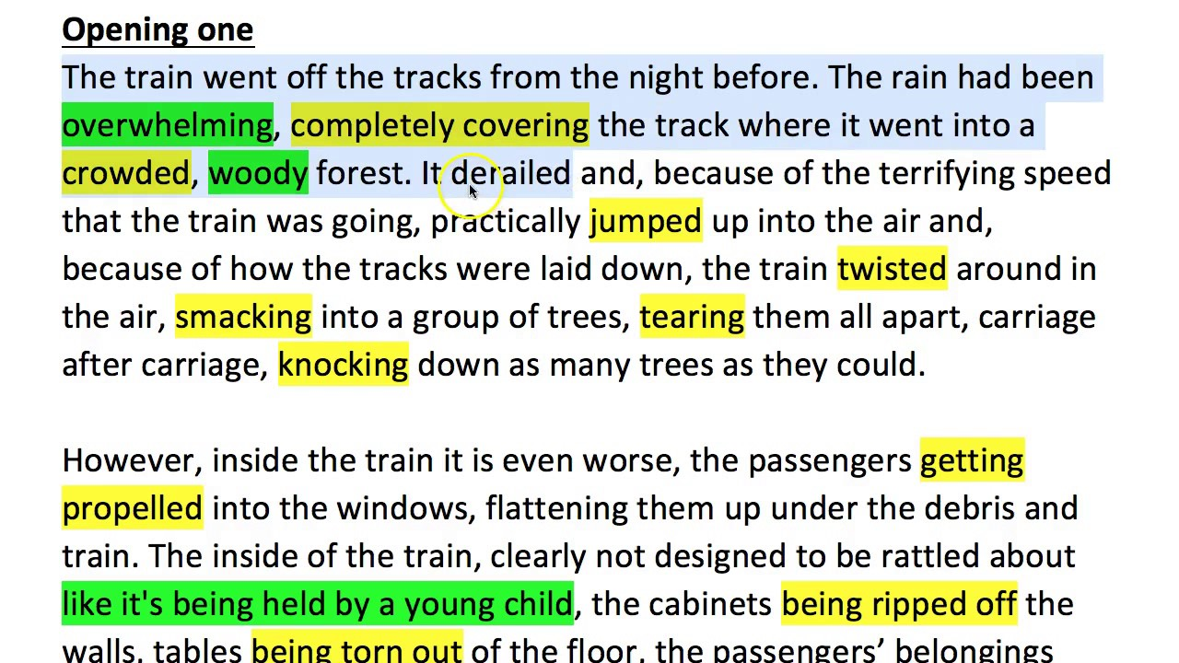
Make use of good descriptive language that evoke images in the listener’s mind
Proper description will account for shape, color, size and other variables. Eg,
Notes:
Ask or prompt the other party for questions for ideas that either party did not understand

Slide 7
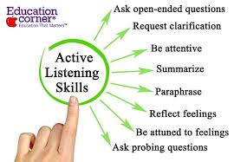
Listening skills
Be patient and listen keenly to the other party because there are no non-verbal cues to help you out.
Do not be tempted to do any other thing at the same time you are making the call.
Notes:
Active listening will allow both parties to hear what the other says and intends rather than taking the words out of context to appeal to what appeals to you.
Also take into account the tone of your voice; keep it light and avoid the feeling of boredom

